Slide 1
CS - 571
Database Systems for BS (IT)
Lecture 1-2: Introduction
Dr. Khurram Shahzad
khurram@pucit.edu.pk
Punjab University College of Information Technology

Slide 2
Agenda
Why database is required?
What is database?
Life without database
More formal definition of database

Slide 3
Have you ever designed a software?

Slide 4
CMS Example

Slide 5
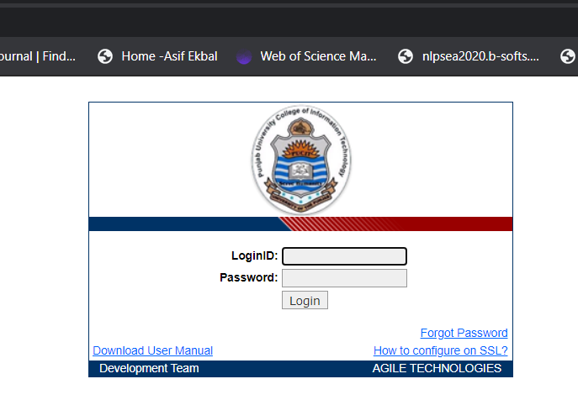

Slide 6
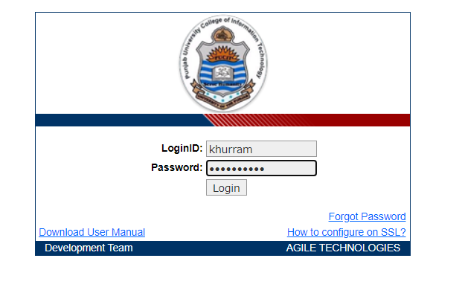
Login to the system

Slide 7
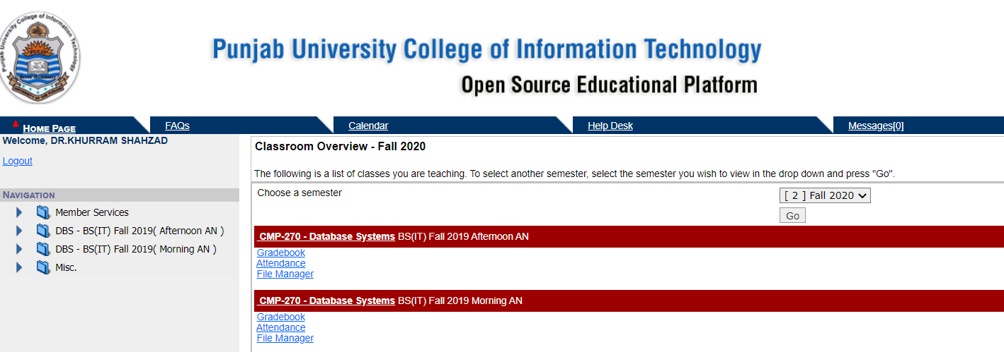
Teacher Dashboard

Slide 8
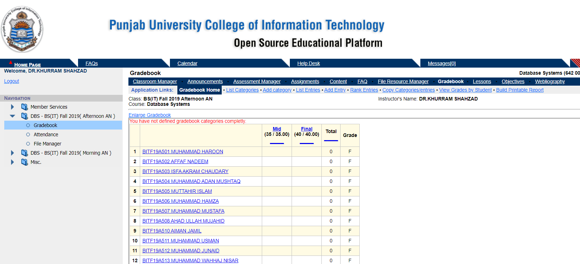
Grading Module

Slide 9
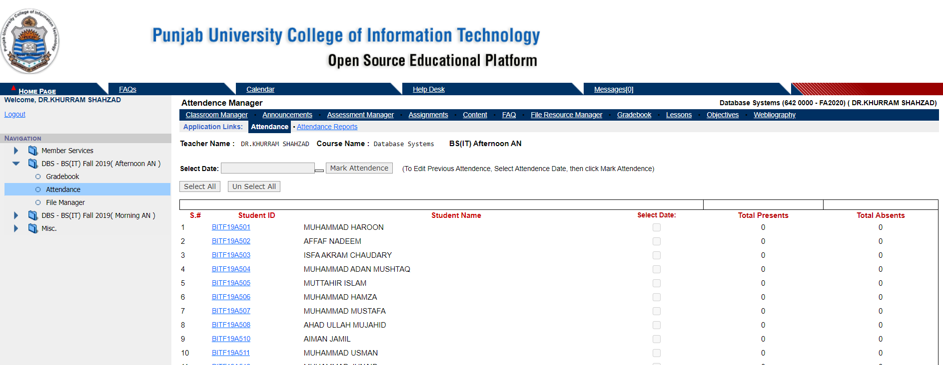
Attendance Module

Slide 10
Have you ever implemented a software?

Slide 11
Have you ever seen the backend of a software?

Slide 12
What is Database?

Slide 13
Database
Def 1: A shared collection of logically related data, designed to meet the information needs of multiple users in an organization

Slide 14
Database
Def 2: An organized collection of information in computarized format

Slide 15
Database Management System
DBMS on the other hand is the software or tool that is used to manage the database and its users

Slide 16
Database Management System
DBMS consist of different components or subsystem that we will study about later
DBMS is a collection of different programs but they all work jointly to manage the data stored in the database and its users

Slide 17
DBMS vs DBs
Database is a collection of data
DBMS is tool to manage this data
Jointly they are called database system

Slide 18
Without Database

Slide 19
Historical Roots of Database
Files and File Systems:
File systems developed to address needs
  Data organized according to expected use
  Data Processing (DP) specialists computerized manual file systems
The spreadsheet alternate

Slide 20

CMS data in spreadsheet
SID | SName | CCode | CName | TMarks | OMarks | Grade | Semester
BITF19M001 | Atif | 570 | DB | 100 | 80 | B+ | Fall 2020
BITF19M001 | Atif | 571 | OOP | 100 | 85 | A | Fall 2020
BITF19M001 | Atif | 572 | PF | 100 | 85 | A | Fall 2020
BITF19M002 | Ali | 570 | DB | 100 | 80 | B+ | Fall 2020
BITF19M002 | Ali | 571 | OOP | 100 | 85 | A | Fall 2020
BITF19M002 | Ali | 572 | PF | 100 | 85 | A | Fall 2020
…

Slide 21
File System Critique
File System Data Management
  Requires extensive programming in third-generation language
  Time consuming
  Depends on physically store data
  Makes ad hoc queries impossible
  Make difficult to modify file system

Slide 22
File System Critique (con’t.)
Data Dependence
  Change in file’s data characteristics requires modification of data access programs
  Must tell program what to do and how to do
  Makes file systems cumbersome from programming and data management views
Structural Dependence
  Change in file structure requires modification of related programs

Slide 23
File System Critique (con’t.)
Field Definitions and Naming Conventions
  Flexible record definition anticipates reporting requirements
  Selection of proper field names important
  Attention to length of field names
  Use of unique record identifiers

Slide 24
File System Critique (con’t.)
Data Redundancy: (Unnecessary Duplication of data)
  Results of uncontrolled data redundancy
    Data anomalies
    Data inconsistency (Different and conflicting versions of same data)
      Lack of data integrity

Slide 25
More formal Database definition

Slide 26
Database
Database is shared, integrated computer structure that stores a collection of data:
  End user data (raw data)
  Metadata (data about data, it contains data characteristics and relationships)

Slide 27
Database Management System (DBMS)
Non-technical
is just a computerized record-keeping system.
Collection of data in the form of files, electronic filing cabinet
A software or application providing operations on the data like, adding new files, inserting new data, retrieving existing data, updating and deleting data,removing files etc.
DBMS is an application, which holds user data permanently and then provide different operations on this data e.g., retrieval of data, insertion of data, updation of data etc.
It is a computerized system whose overall purpose is to maintain information and to make that information available on demand.

Slide 28
Database Management
Database Management System (DBMS): software system (collect of software) help to manage the data contents
  Manages Database structure
  Controls access to data
  Contains query language
Application software
DBMS
Database

